Slide 1
Session #: 810
Excel 301: Take the Elevator to the Next floor: Macros
Download session documents at:
http://www.rcm-hrs.com/motm2017.html
Presenters Name: David Pena, Hrair Tcholakian

Slide 2
Agenda
What are macros?
When do you use macros?
Simple macros
Complex macros
Finale – Demonstration
Q&A

Slide 3
What Are Macros?

Slide 4
What are macros?
A single instruction that expands automatically into a set of instructions to perform a particular task
Macros you use all the time include
Cut CTRL+X
Copy CTRL+C
Paste CTRL+V
Paste special CTRL+ALT+V
New CTRL+N
Save CTRL+S

Slide 5
What are macros?
Excel macros can be executed by assigning to a
Push button (AKA object)
Keyboard shortcut
Macros can execute a “sub macro”

Slide 6
When do you use
macros?

Slide 7
When do you use macros?
For tedious, repetitive tasks you want to simplify or automate
Format entire document (font, color, etc.)
Format columns or rows
Delete columns or rows
Insert columns or rows
Insert calculations or formulas
Merge/unmerge columns
Transform spreadsheet data

Slide 8
When do you use macros?
To validate benefit elections using vendor and ADPR reports
Create an ADPR report in .csv format
Run a macro to combine the 2 reports
Run a macro to format the fields
Run a macro to reconcile the vendor data to the system data

Slide 9
When do you use macros?
Analyze PTO balances against budget
Track employee costs by project
Create an EPIP file to load commissions

Slide 10
Create a simple macro
Record a macro
Review macro code
Execute the macro

Slide 11
Record a macro
NOTE: If the Developer tab is not available, do the following to display it:
Click the File tab
Click Options, and then click Customize Ribbon
In the Customize Ribbon category, in the Main Tabs list, select the Developer check box, and then click OK

Slide 12
Record a macro
Unless you’re proficient in VB Script, the easiest way to create a macro is to record it
The macro recorder records all the steps you do to complete the actions you want your macro to perform

Slide 13
Record a macro
Click on Record Macro
Enter a name and a shortcut
Select Personal Macro Workbook to have macros available for any workbook
Modify the spreadsheet
Click Stop Recording

Slide 14
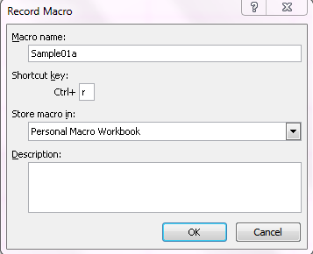
Record a macro
1
2

Slide 15
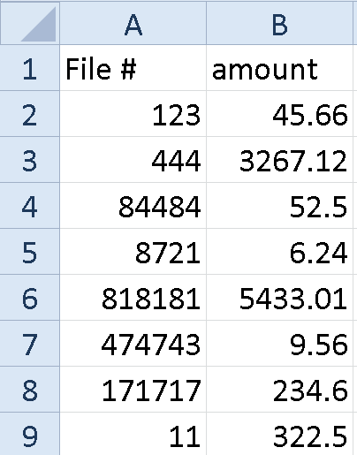
Record a macro
3. Modify the spreadsheet
A1: Change to Filenbr
Moved cursor to A2
CTRL+ SHIFT+down arrow
Right click, select Format Cells
Select Custom
Enter 000000
Click OK

Slide 16
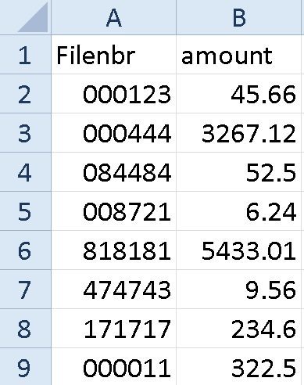
Record a macro
4. Click Stop Recording

Slide 17
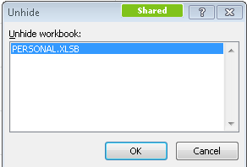
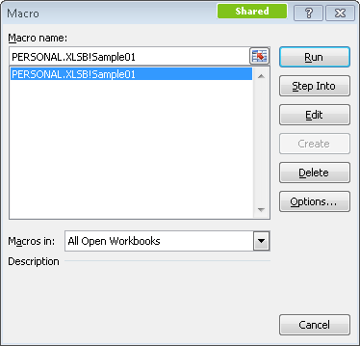
Review macro code
Click on View – Unhide
Select Personal.xlsb
Click OK
NOTE: Personal.xlsb appears; click Save
Click on Developer – Macros
Select Macro
Click Edit

Slide 18
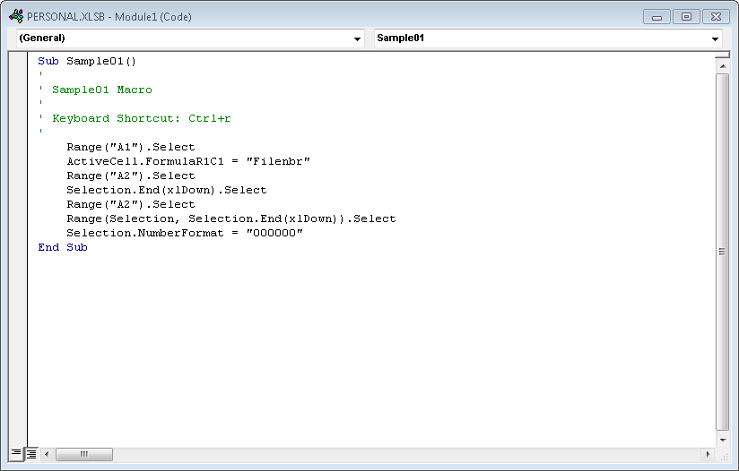
Review macro code

Slide 19
Execute a macro
Run the macro with your shortcut key

Slide 20
Simple Macro
Demo

Slide 21
Complex macros
Record a macro
Review macro code
Execute the macro

Slide 22
Complex macros
Create 3 importable EPIP batch files from templates from 3 comp analysts for commissions

Slide 23
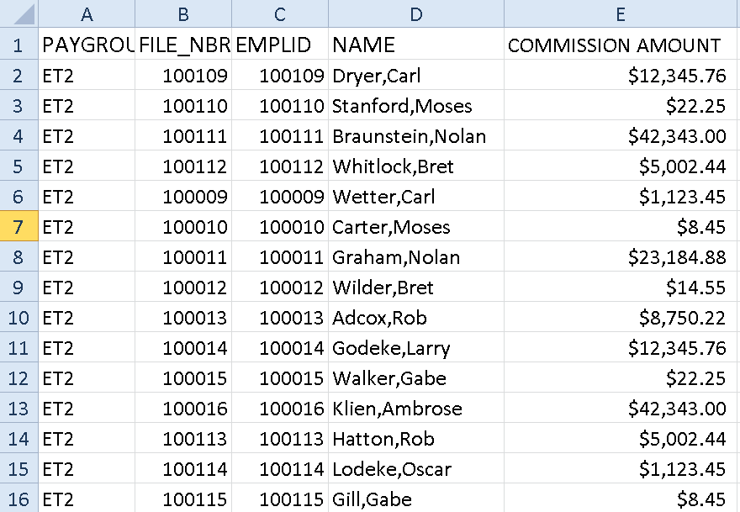
Complex macros – original file

Slide 24
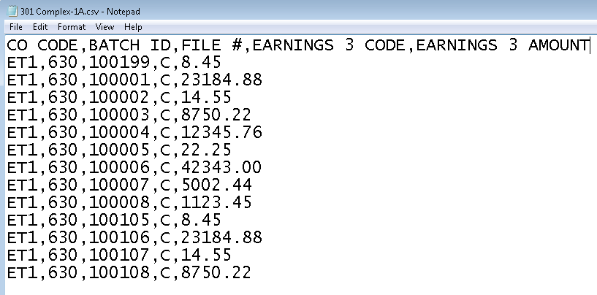
Complex macros – final file

Slide 25
Complex macros
Useful reference on macro code:
https://msdn.microsoft.com/en-us/library/office/ee814737(v=office.14).aspx

Slide 26
Complex Demo

Slide 27
Final Project
Demo

Slide 28
Questions
Notes:
Patti

Slide 29
RCM contact information
David Peña Vice President David.Peña@rcmt.com 973.588.8322 office
Hrair Tcholakian
Senior Director Hrair Tcholakian@rcmt.com 973.588.8316 office
You can download this presentation at: http://www.rcm-hrs.com

Slide 30
DON’T FORGET TO COMPLETE THE SESSION EVALUATION ON THE ADP MOTM CONFERENCE APP.
Thank You
Session #: 810
Excel 301: Take the Elevator to the Next floor: Macros

